Slide 1
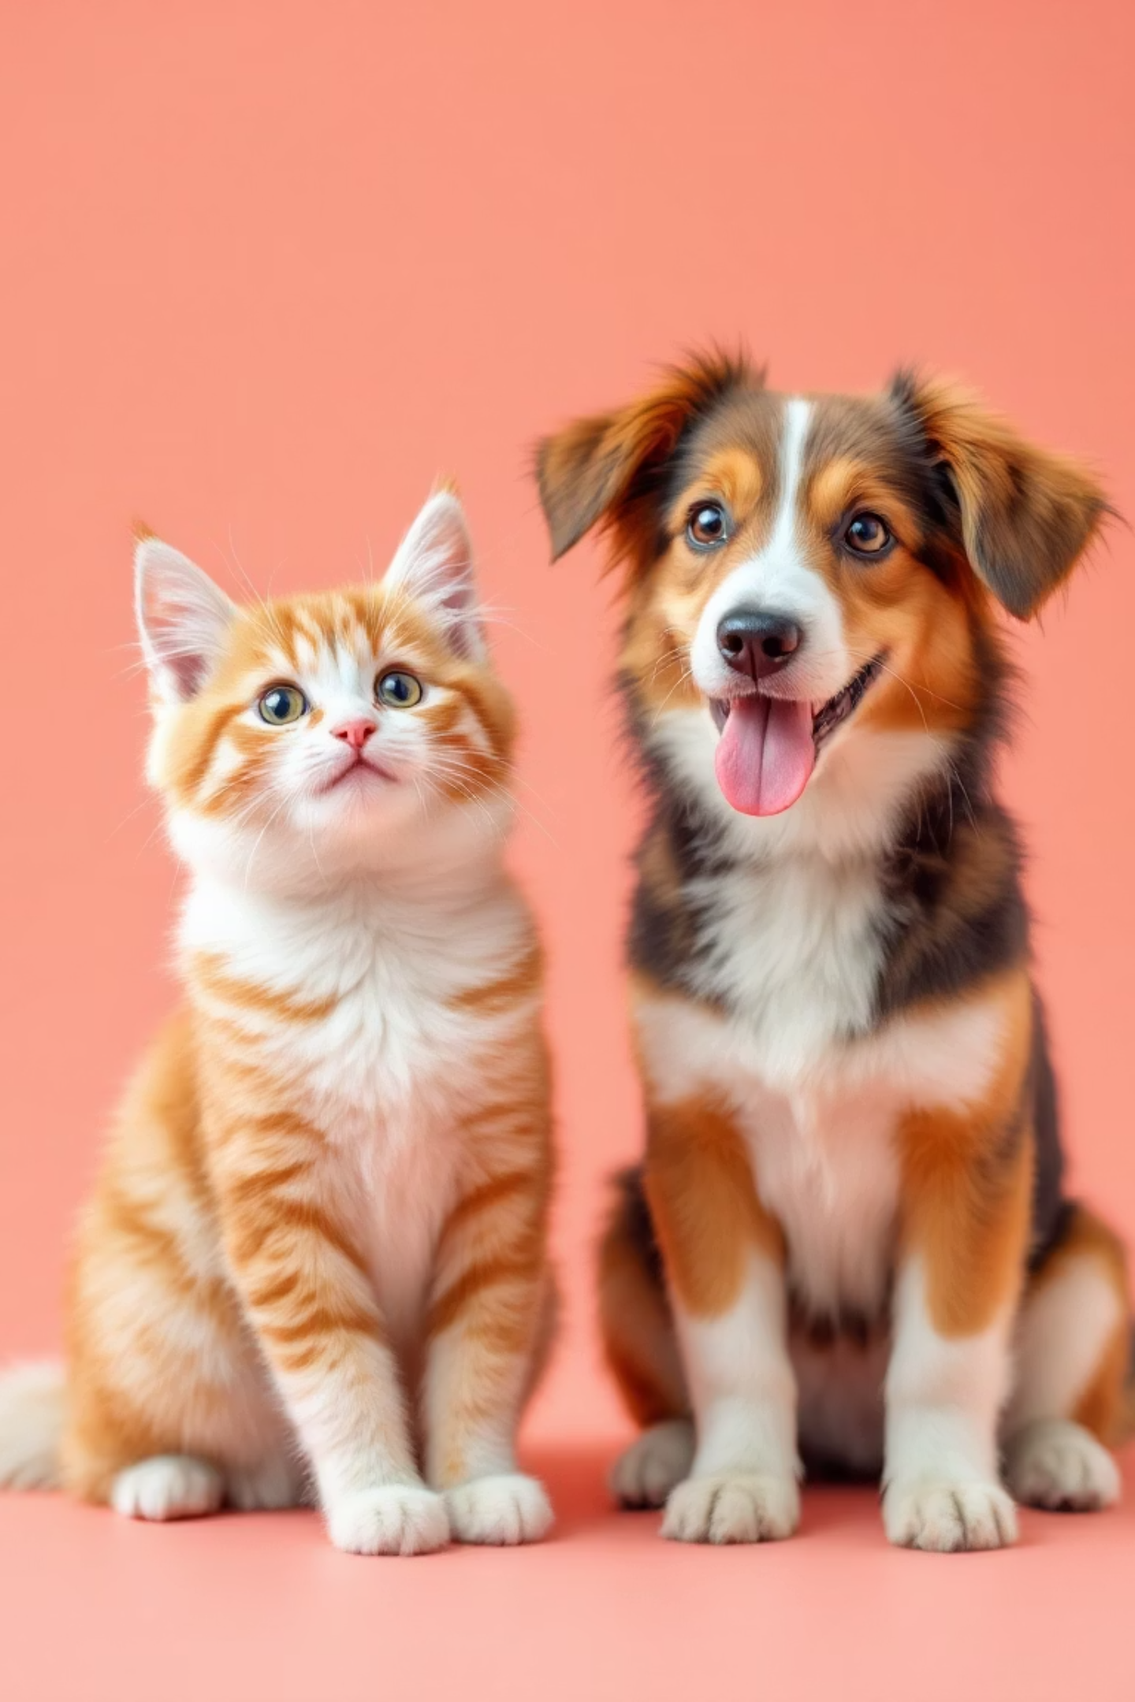
🐶🐱 Cats vs Dogs Image Classification
Deep Learning with TensorFlow/Keras on Google Colab

Slide 2
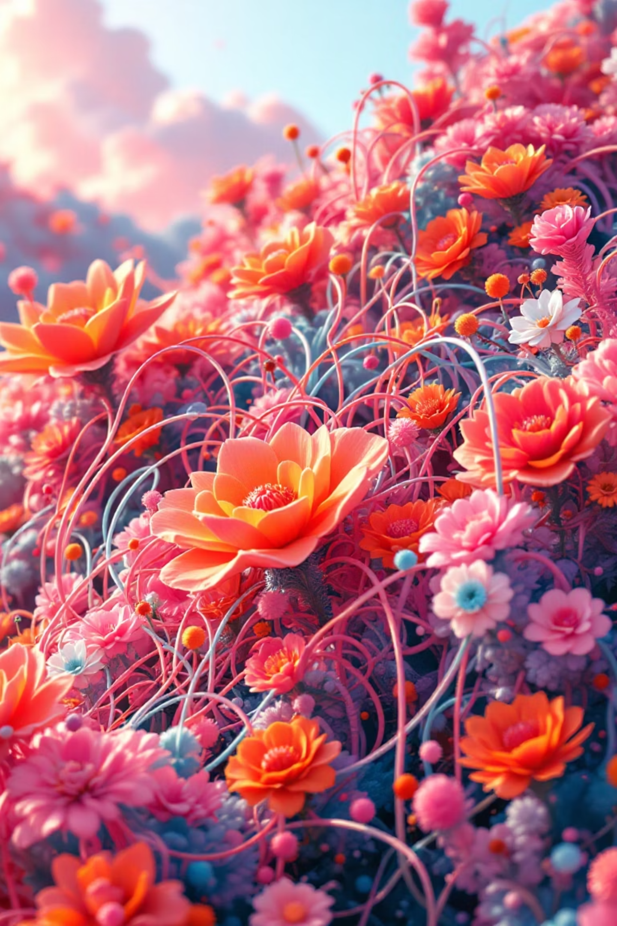
📌 Project Overview
Goal
Classify images into 2 categories: Cat 🐱 or Dog 🐶 using deep learning techniques
Technology Stack
Built using TensorFlow/Keras framework on Google Colab for accessible cloud computing
Dataset Scale
25,000 training images and 12,500 testing images for robust model performance
Results
Achieved approximately 90% accuracy in classification tasks

